Slide 1
Addressing the Needs of the US Rice Industry
– An Overview of the USDA-ARS Dale Bumpers
National Rice Research Center
Yulin Jia
Center Director/Research Leader

Slide 2
The Dale Bumpers National Rice Research Center in Stuttgart, Arkansas is the largest facility in USDA-ARS with the sole focus on rice research.
Notes:
ARS Has: $1.1 B Budget, X Locations, 8000 Employees and 1900 Scientists

Slide 3
USA Rice Acreage
DBNRRC

Slide 4
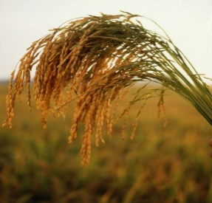
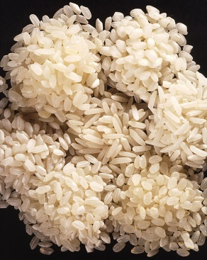
Mission Driven Research
The mission of the Dale Bumpers National Rice Research Center is to improve the competitiveness of the U.S. rice industry in global and domestic markets through research and technology development that assures high yields, value-added grain quality, pest resistance, and stress tolerance.
DBNRRC Rice Research Effort
10%
90%
Researchers
Extension
Farmers, Seedsmen
Millers, Processors
Consumers

Slide 5
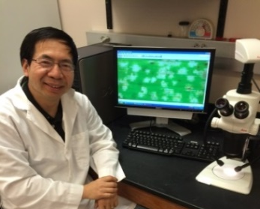
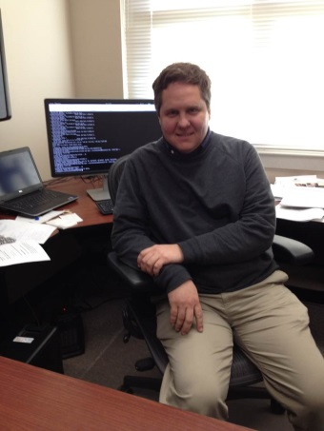
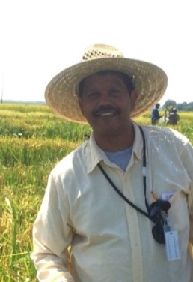
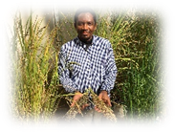
Scientific Staff at
Dale Bumpers National Rice Research Center
Yulin Jia
Host- Pathogen Interactions
Georgia Eizenga
Wild Crop Relatives
Shannon Pinson
Gene Mapping
Jeremy Edwards
Bioinformatics
Jai Rohila
Abiotic Stress
Trevis Huggins
Germplasm Curator

Slide 6
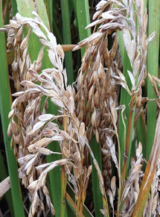
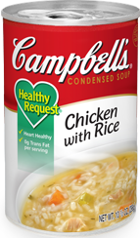
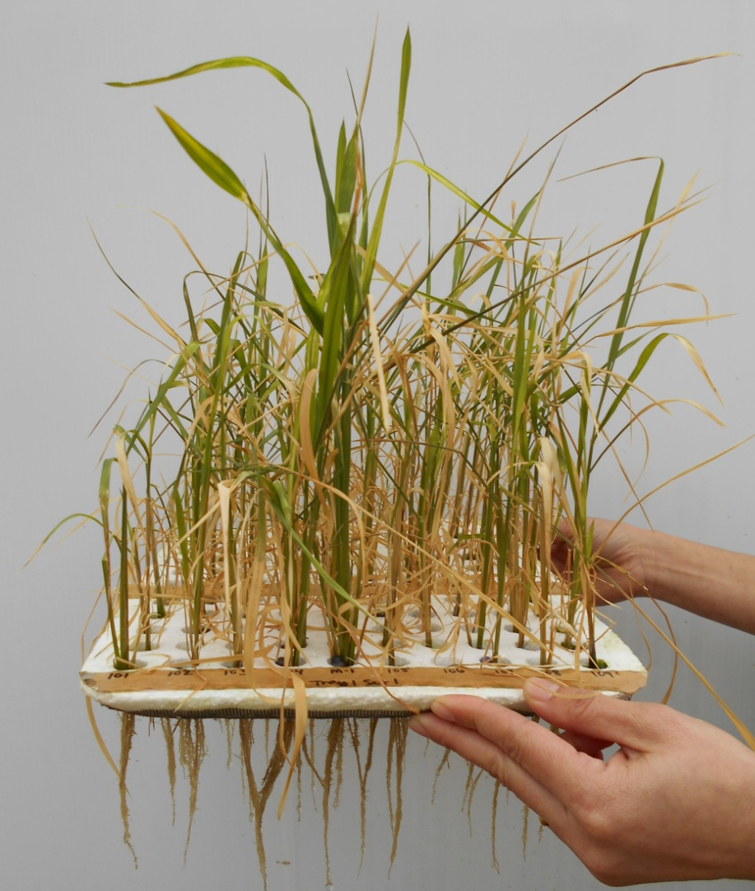
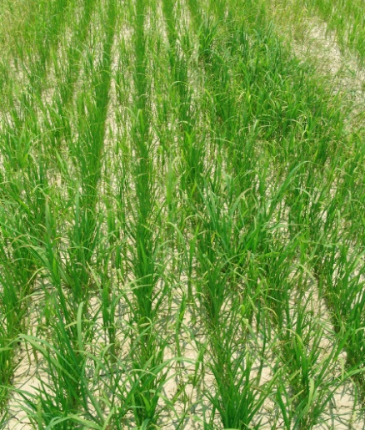
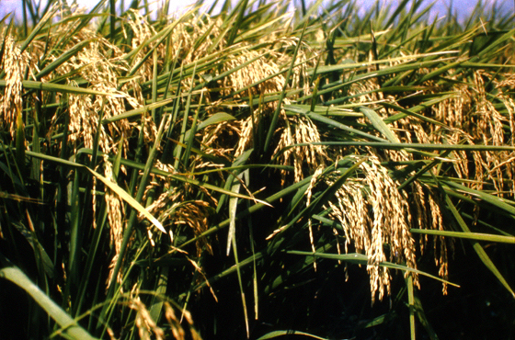
Research Approach
Rice Germplasm Characterization
Disease
Resistant
Gene Discovery
Enhanced Nutrition
And Processing
Quality
Marker Assisted
Breeding
Resilient to
Climate Change
Open Access, Improved Rice
Germplasm
Weed
Suppressive
Improved
Yield
Research Outcome

Slide 7
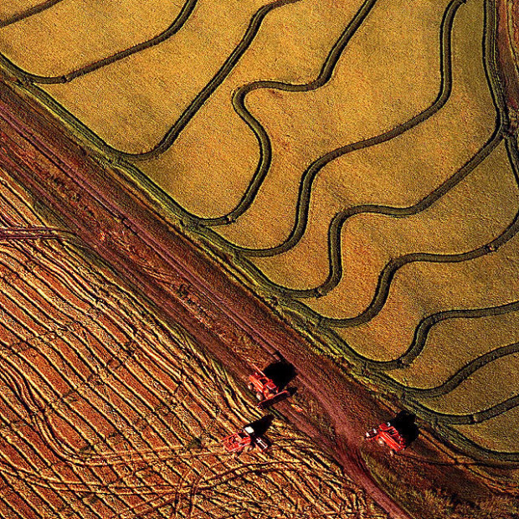
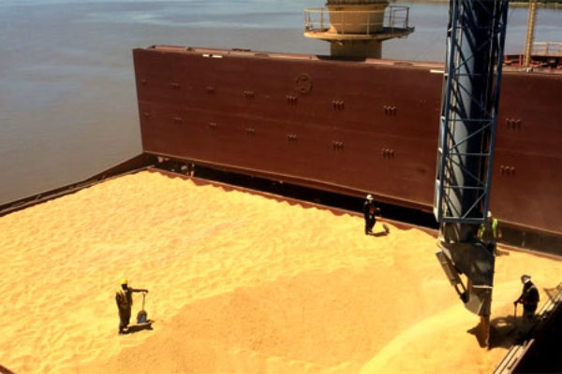
USA Rice Production Facts
3.5 M acres of rice are planted in the USA
74% of USA rice produced is long grain rice
50% of US rice is produced in Arkansas
50% of US rice produced is exported
Our largest export market is Mexico

Slide 8
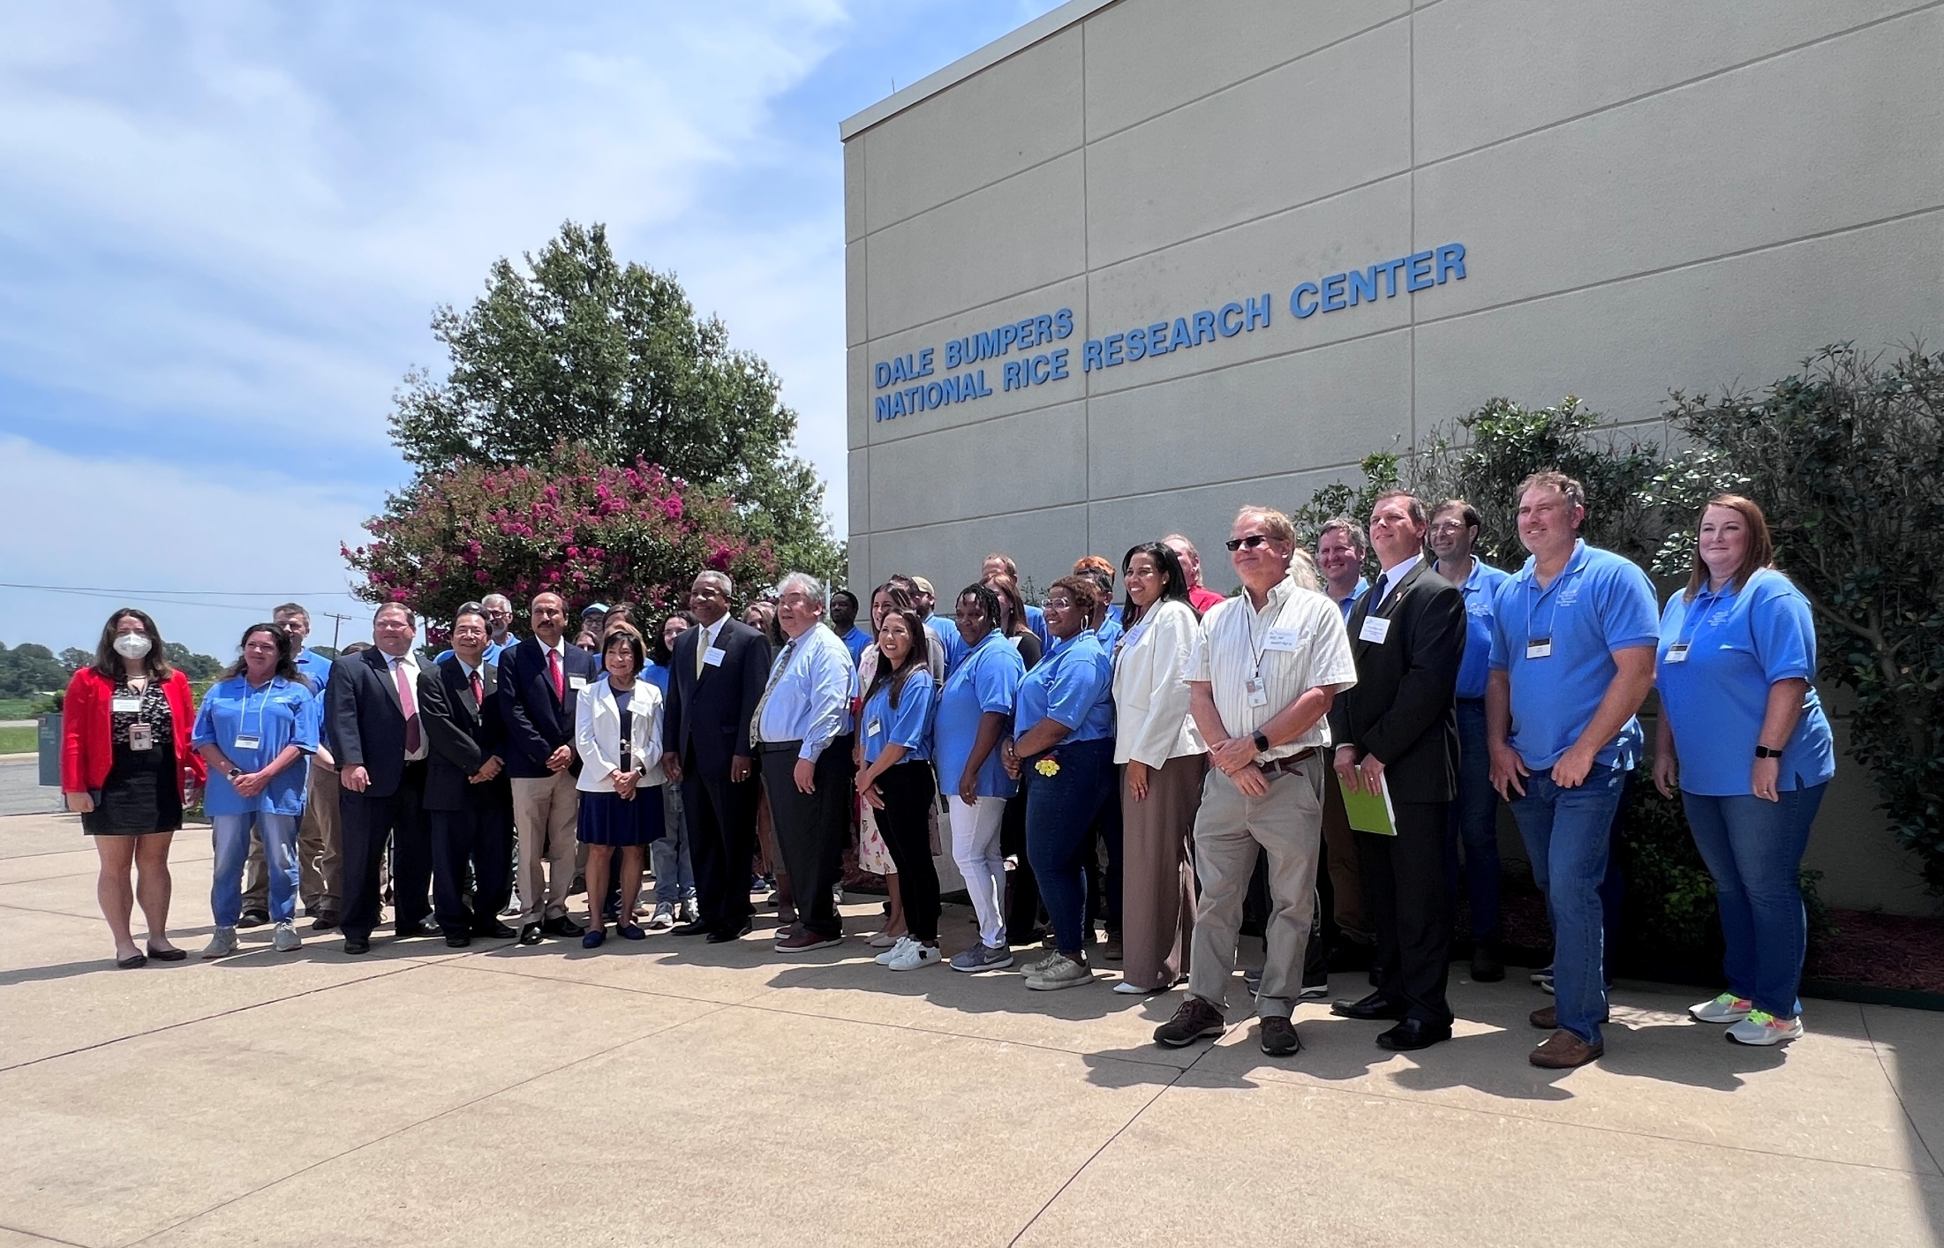
USDA Employees at 25th Anniversary of Dale Bumpers National Rice Research Center

